Slide 1
An Energy-efficient MAC protocol for Wireless Sensor Networks
Wei Ye, John Heidemann, Deborah Estrin
presented by
Xiang Li

Slide 2
Outline
Introduction to WSN
Design considerations
Energy inefficiency Sources
Existing MAC protocol design
S-MAC
Testbed and Implementation
Result and Analysis
Conclusion and future work

Slide 3
Introduction to WSN
Applications:
  Nodes cooperate for a common task
  In-network data processing
Differences between WSN and ad-hoc network
  Battery powered nodes → Energy efficiency
  Large quantity of densely deployed nodes
  This dense deployment brings high degree of interactions
  Resources constraint
  Auto configuration and auto organization

Slide 4
Design Considerations
Level 1 issues
  Collision avoidance-a basic task of MAC protocols
  Good scalability
  Energy efficiency
  -Often difficult recharge batteries or replace them
  -Prolonging the life-time is important
Level 2 issues
  Latency, fairness, throughput, bandwidth

Slide 5
Energy Inefficiency Sources
Collision
  Corrupted packets must be retransmitted and it increases energy consumption
Overhearing
  Receive packets destined to others

Slide 6
Energy Inefficiency sources
Control packet overhead
Idle listening
  Listening to receive possible traffic that is not sent→ Dominant energy inefficiency factor in WSN
  Consumes 50-100% of the energy required for receiving

Slide 7
Existing MAC protocol design
Contention based protocols
  IEEE 802.11 distributed coordination function (DCF)
    Each nodes contends for the medium as necessary and wastes a lot of energy in idle listening
  PAMAS
    Asking separate radio channel for RTS/CTS
    Does not address the issue of reduce idle listening

Slide 8
TDMA based protocols
  Advantages
    lower energy conservation when compared to contention based as the duty cycle of the radio is reduced and no contention overhead
  Problems
    Requires nodes to form real communication clusters and managing inter-cluster communication is difficult
    It is not easy to change the slot assignment dynamically, hence scalability is not as good as contention based

Slide 9
S-MAC
Design
  Goal
    Reduce energy consumption
    Support good scalability and collision avoidance
  Solutions to energy inefficiency issues
    Collision avoidance - using RTS and CTS
    Overhearing avoidance - switching the radio off when the transmission is not meant for that node
    Control overhead - Message Passing
    Idle listening - Periodic listen and sleep

Slide 10
Trade offs between energy efficiency and performance (1)
Trade-offs of per-hop fairness and latency
This does not necessarily result in lower end-to-end fairness and latency

Slide 11
Trade offs between energy efficiency and performance (2)
It is important in wireless voice or data networks as each user desires equal opportunity and time to access the network
Is it important for sensor networks?
  In sensor networks all nodes co-operate and work together for a single application
  So per-hop fairness is not important as long as application level performance is not degraded.

Slide 12
Network assumptions (1)
Composed of many small nodes deployed in an ad hoc fashion
Most communication will be between nodes as peers, rather than to a single base station
Nodes must self-configure

Slide 13
Network assumptions (2)
Dedicated to a single application or a few collaborative applications
Involves in-network processing to reduce traffic and thereby increase the life-time
This implies that data will be processed as whole messages at a time in store-and-forward fashion
Hence packet or fragment-level interleaving from multiple sources only delays overall latency
Applications will have long idle periods and can tolerate some latency

Slide 14
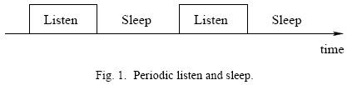
Periodic listen and Sleep (1)
Problem: Idle listing wastes a lot of energy
Solution: Periodic listen and sleep
Turn off radio when sleeping
Reduce duty cycle to ~ 10% (200ms on/2s off)

Slide 15
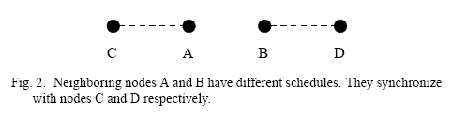
Periodic listen and Sleep (2)
Not all neighboring nodes can synchronize together
Two neighboring nodes (A and B) can have different schedules if they are required to synchronize with different node

Slide 16
Periodic listen and Sleep (3)
If a node A wants to talk to node B, it just waits until B is listening
If multiple neighbors want to talk to a node, they need to contend for the medium
Contention mechanism is the same as that in IEEE802.11 (using RTS and CTS)
After they start data transmission, they do not go to periodic sleep until they finish transmission

Slide 17
Periodic listen and Sleep (4)-choosing and maintaining schedules
Each node maintains a schedule table that stores schedules of all its known neighbors.
To establish the initial schedule (at the startup) following steps are followed:
  A node first listens for a certain amount of time.
  If it does not hear a schedule from another node, it randomly chooses a schedule and broadcast its schedule immediately.
  This node is called a SYNCHRONIZER.
  If a node receives a schedule from a neighbor before choosing its own schedule, it just follows this neighbor’s schedule.
  This node is called a FOLLOWER and it waits for a random delay and broadcasts its schedule.
  If a node receives a neighbor’s schedule after it selects its own schedule, it adopts to both schedules and broadcasts its own schedule before going to sleep.

Slide 18
Periodic listen and Sleep (5)- Maintaining Synchronization
Timer synchronization among neighbors are needed to prevent the clock drift.
Done by periodic updating using a SYNC packet.
Updating period can be quite long as we don’t require tight synchronization.
Synchronizer needs to periodically send SYNC to its followers.
If a follower has a neighbor that has a different schedule with it, it also needs update that neighbor.

Slide 19
Time of next sleep is relative to the moment that the sender finishes transmitting the SYNC packet
Receivers will adjust their timer counters immediately after they receive the SYNC packet
Listen interval is divided into two parts: one for receiving SYNC and other for receiving RTS

Slide 20
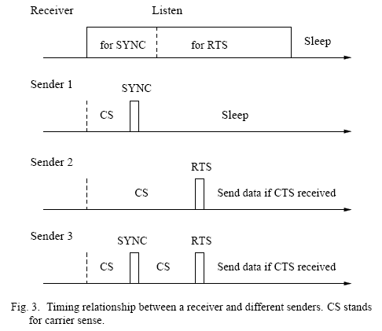
Periodic listen and Sleep (6)-
Timing Relationship of Possible Situations

Slide 21
Collision Avoidance
Problem: Multiple senders want to talk
Solution: Following IEEE 802.11 ad hoc procedures
  Physical and virtual carrier sense
  Randomized backoff time
  RTS/CTS for hidden terminal problem
  RTS/CTS/DATA/ACK sequence

Slide 22
Overhearing Avoidance
Problem: Receive packets destined to others
  In 802.11, each node keeps listening to all transmissions from its neighbors for virtual carrier sensing
  Each node should overhear a lot of packets not destined to itself
Solution: Letting interfering nodes go sleep after they hear an RTS or CTS packet
Which nodes should sleep?
  All immediate neighbors of sender and receiver
  S-MAC lets interfering nodes go to sleep after they hear an RTS or CTS
    DATA packets are normally much longer than control packets
How long?
  The duration field in each packet informs other nodes the sleep interval
  After hearing the RTS/CTS packet destined to a node, all the other immediate neighbors of both the sender and receiver should sleep until the NAV becomes zero

Slide 23
Message Passing
Problem: Sensor net in-network processing requires entire message
Solution: Don’t interleave different messages
  Long message is fragmented & sent in burst
  RTS/CTS reserve medium for entire message
  Fragment-level error recovery — ACK
  — Extend Tx time and re-transmit immediately if no ACK is received
Advantages
  Reduces latency of the message
  Reduces control overhead
Disadvantage
  Node-to-node fairness is reduced, as nodes with small packets to send has to wait till the message burst is transmitted

Slide 24
Protocol Implementation
Testbed
  Rene motes, developed at UCB
  They run TinyOS, an event-driven operating systems
  Two type of packets
    Fixed size data packets with header (6B), payload (30B) and CRC (2B)
    Control packets (RTS and CTS), 6B header and 2B CRC

Slide 25
MAC modules implemented
Simplified IEEE 802.11 DCF – physical and virtual carrier sense, backoff and retry, RTS/CTS/DATA/ACK packet exchange and fragmentation support
Message passing with overhearing avoidance
The complete S-MAC – all the features are implemented

Slide 26
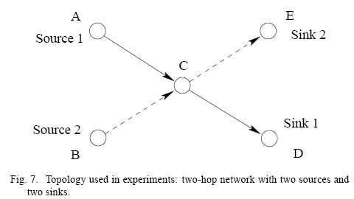
Topology
Two-hop network with two sources and two sinks
Sources generate message which is divided into fragments
Traffic load is changed by varying the inter-arrival period of the message

Slide 27
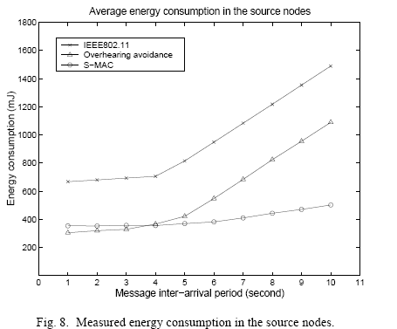
Energy consumption in the source nodes

Slide 28
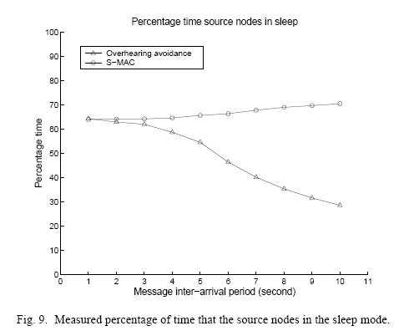
Percentage of time that the source nodes are in the sleep mode

Slide 29
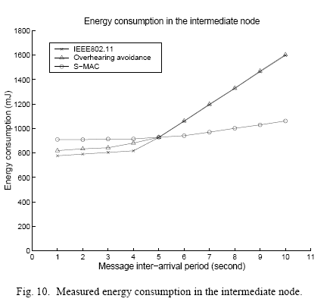
Energy consumption in the intermediate node

Slide 30
Conclusions and Future work
Conclusion:
  S-MAC offers a significant improvement on energy efficiency properties comparing to IEEE 802.11
Future work
  Experiment on large scale deployment
  Analysis on the effects brought by topology change

